Slide 1
A Review of vulnerabilities in GPUs: Related Attacks, Threats, Defenses, and Fixes
Nick Arellano
Nathan Ketterlinus
Ayomide Owoade

Slide 2
The Increasing Importance of GPUs
Parallelism
Encryption
Deep Learning
Cloud Computing
The GPU is being used much more commonly in never-before-seen areas
Inadequate security research

Slide 3
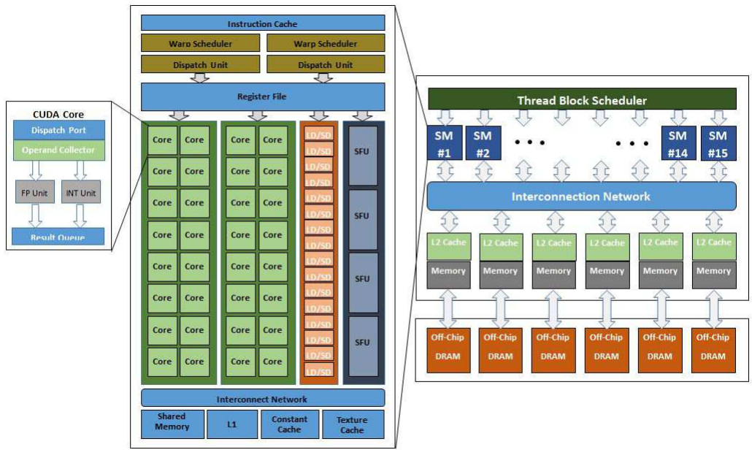
GPU Architecture
GPU work is divided into threads
32 threads = 1 warp
Warps are handled by Streaming Multiprocessors (SMs)
SIMD execution units
Load/Store Units
Special Function Units
Memory Coalescer unit combines duplicate memory requests
Several architectures, all follow the same basic principles

Slide 4
What is AES Encryption?
Symmetric encryption algorithm
Single key for encryption AND decryption
Initial key is 128 bits, 16 bytes
4x4 array of each byte is scrambled
10 rounds of 4 operations each
SubByte, ShiftRow, MixColumn, AddRoundKey

Slide 5
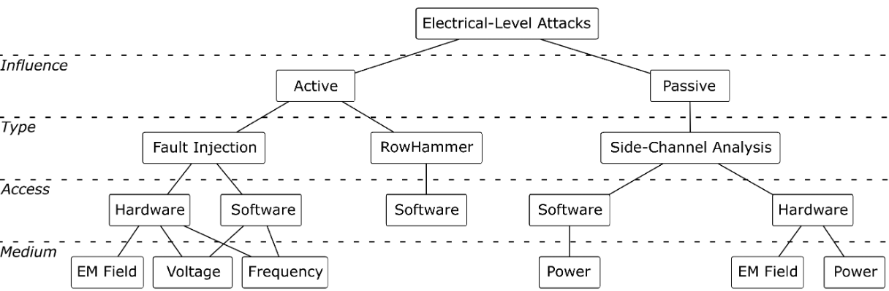
What is a Side Channel Attack
Passive Electrical-level Attack
Deals with physical & microarchitectural Properties of hardware
Transmitter + Receiver
Hidden Channel

Slide 6
Types of Side Channel Attacks
Temperature
Power
Magnetic emanation
Sound
Timing
Cache collision
Dynamic Voltage Frequency Scaling (DVFS)

Slide 7
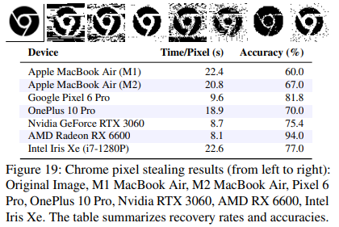
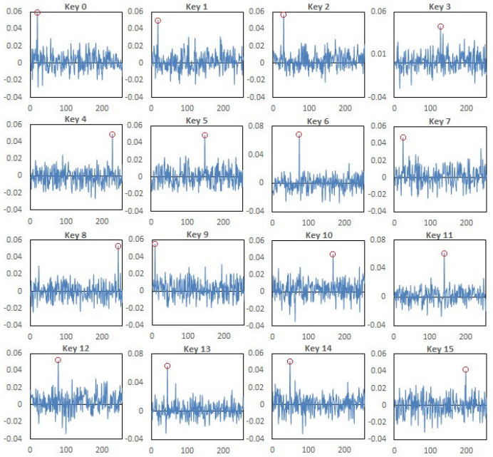
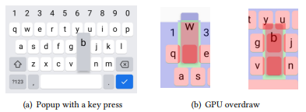
What can these attacks do?
Recover search history
Recover AES Keys
Log Keystrokes
Infer activities
Rebuild seen images

Slide 8
Countermeasures
Handle each discovered vulnerability on a case-by-case basis
Develop architectures with adversarial thinking
Most solutions include adding overhead, which can limit performance
Operating under voltage/frequency limits
Adding additional noise
Calls to memory

Slide 9
Thank You!
Contact us @
narella1@students.towson.edu
nketter1@students.towson.edu
aowoade1@students.towsoon.edu

